Slide 1

AgriMarket
Profit Optimizer
By Sarthak Mehta and Sandeep Yadav
To view this presentation in an interactive mode, click here

Slide 2

This presentation details the development of a code designed to help farmers and traders maximize their profits in the Indian agricultural market. The code analyzes real-time market data, integrates transportation costs, and recommends the most profitable market for selling produce.

Slide 3

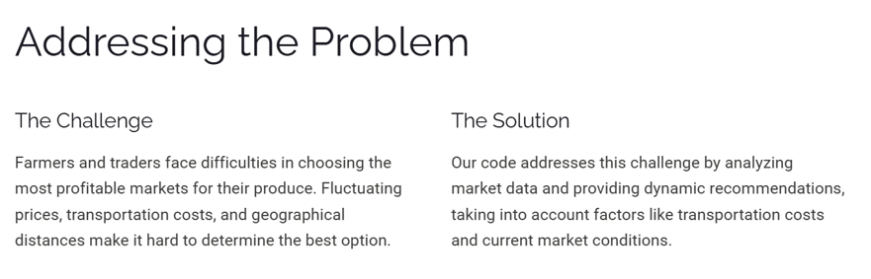

Slide 4
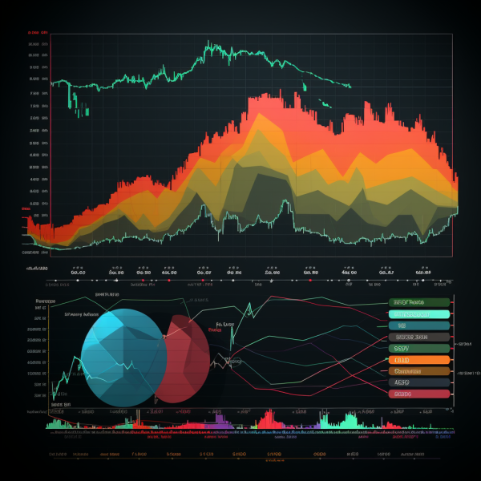
Dataset Overview
The code utilizes a time series dataset containing information on 325 different commodities sold across all mandis/APMC markets in India. The dataset spans from January 1st, 2000, to February 1st, 2024. Each record includes details such as state, district, market, variety, arrival quantities, minimum, maximum, and modal prices. It offers a comprehensive snapshot of India's agricultural market.

Slide 5
Libraries and Modules used
The os module is used for file and folder management, enabling the script to navigate directories, list .csv files, and check file sizes. Pandas handles data manipulation, allowing the reading, filtering, and combining of datasets into structured DataFrames for analysis. Geopy is employed to calculate distances between locations by geocoding city names into coordinates and determining the geodesic distance, which is crucial for estimating transportation costs. Together, these libraries facilitate efficient data processing and geographical computations.

Slide 6

Key Functions Used in the Code

Slide 7
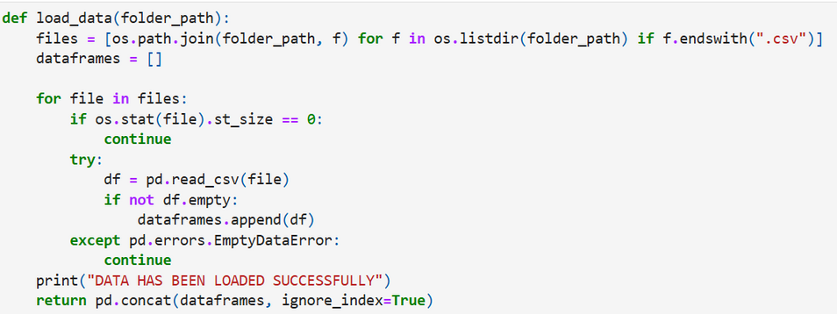

load_data(folder_path)
This function is responsible for loading all the CSV files from the specified folder path (folder_path). It scans the folder, identifies files with a .csv extension, and attempts to read them into a Pandas DataFrame. Empty files are skipped to prevent errors. If a file contains valid data, it is appended to a list of DataFrames. Finally, all the DataFrames are concatenated into a single DataFrame. This ensures that all market data is consolidated for further analysis. The function also ensures the script does not crash by handling empty datasets gracefully.
get_latest_data(df)
This function filters the loaded dataset to include only the most recent data based on the Reported Date column. It first identifies the latest date present in the dataset and then extracts rows corresponding to this date. This step ensures that the analysis is conducted using up-to-date information, making the recommendations relevant for the current market conditions.

Slide 8
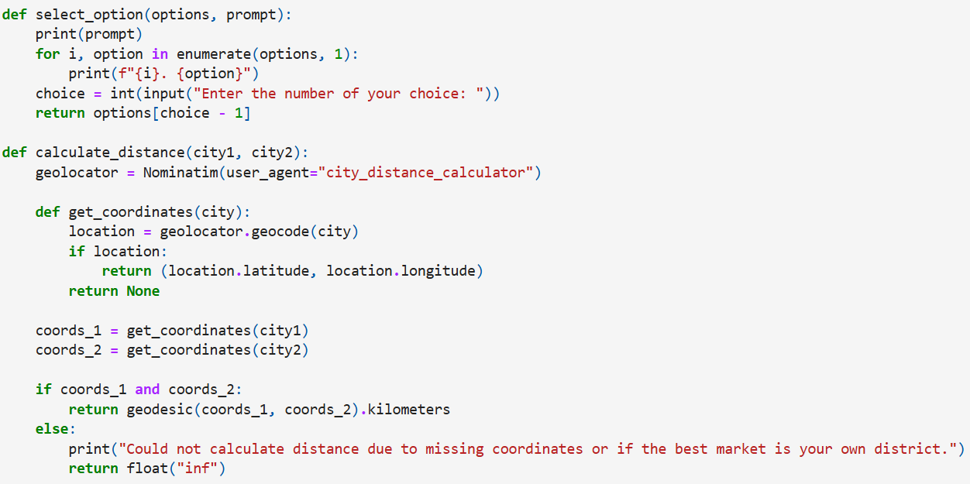

select_option(options, prompt)
This function simplifies the process of user interaction by providing a menu-based interface. It takes a list of options and a prompt as input and displays the options to the user. The user selects an option by entering the corresponding number. The function validates the input and returns the selected option. This structured approach prevents errors and makes the script user-friendly.
calculate_distance(city1, city2)
This function calculates the geographical distance between two cities using the Geopy library. It defines a helper function, get_coordinates(city), which retrieves the latitude and longitude of a given city using Geopy’s geocode function. Once the coordinates of both cities are obtained, the geodesic distance between them is calculated. If the coordinates are missing or cannot be retrieved, the function prints a message and returns infinity (inf) to indicate that the distance cannot be calculated. This function is crucial for factoring in transportation costs between markets.

Slide 9
calculate_transport_cost(distance_km, weight_kg)
This function calculates the transportation cost based on the distance between the user’s district and the target market’s district, as well as the weight of the commodity being transported. The formula used is:
Cost=Distance (in km)×Weight (in kg)×Cost per kg per kmCost=Distance (in km)×Weight (in kg)×Cost per kg per km
The TRANSPORTATION_COST_PER_KG_PER_KM constant, set at Rs. 3.6, is used in the calculation. This function is vital for assessing the net profit after deducting transportation expenses.
main()
The main function is the core of the script, orchestrating the entire workflow. It begins by allowing the user to select their state, district, market, commodity, and variety through sequential calls to select_option. The user also inputs the quantity of the commodity they wish to sell. The function then calculates the selling price at the user’s selected market using the modal price and quantity. Next, the function iterates through all markets within the same state where the selected commodity and variety are available. For each market, it calculates the net selling price. If the market is not the user's selected market, it factors in transportation costs using calculate_distance and calculate_transport_cost. The profit difference relative to the user's chosen market is computed for each market, and the results are stored in a new column, Profit Relative to Chosen Market.

Slide 10
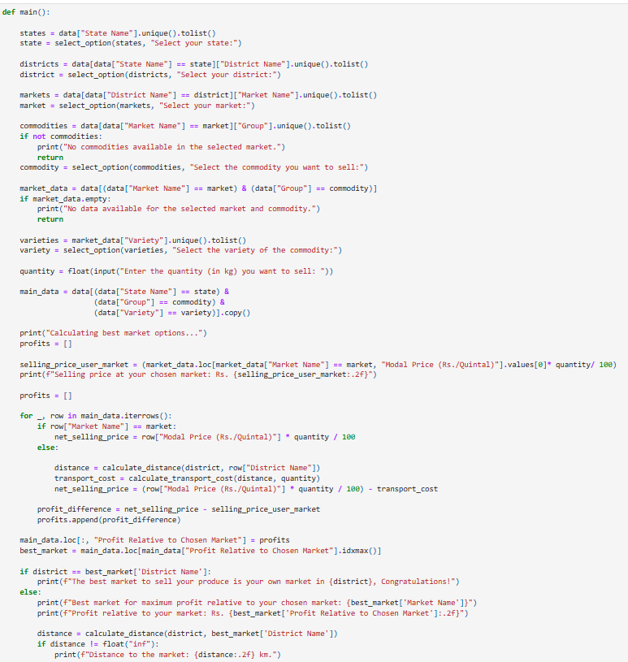
Finally, the function identifies the market with the highest profit relative to the user's market. If the user's market is the most profitable, it congratulates them. Otherwise, it provides details about the best market, including its name, profit difference, and distance from the user's district.

Slide 12
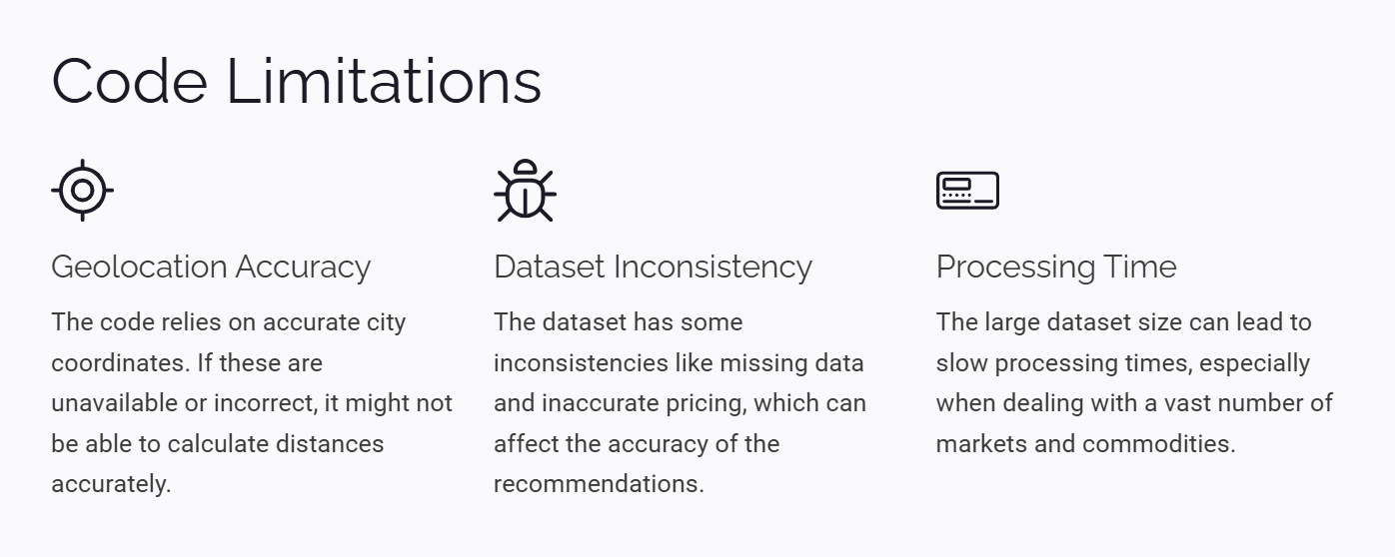

Slide 13

Future Enhancements
The code has the potential for future improvements, such as implementing more robust error handling for data inconsistencies, incorporating more granular transportation cost models, and exploring alternative data sources to enhance accuracy and broaden coverage. Continuous development will ensure the code becomes even more effective in guiding farmers and traders towards optimal profit generation.

Slide 14
Thank You
Prepared By
Sarthak Mehta (24103143) and Sandeep Yadav (24103141)

